Slide 1


ENTERPRISE VIRTUAL ASSISTANT
MAY 2025
Notes:
Make a hook story about how to make QA life easier

Slide 2


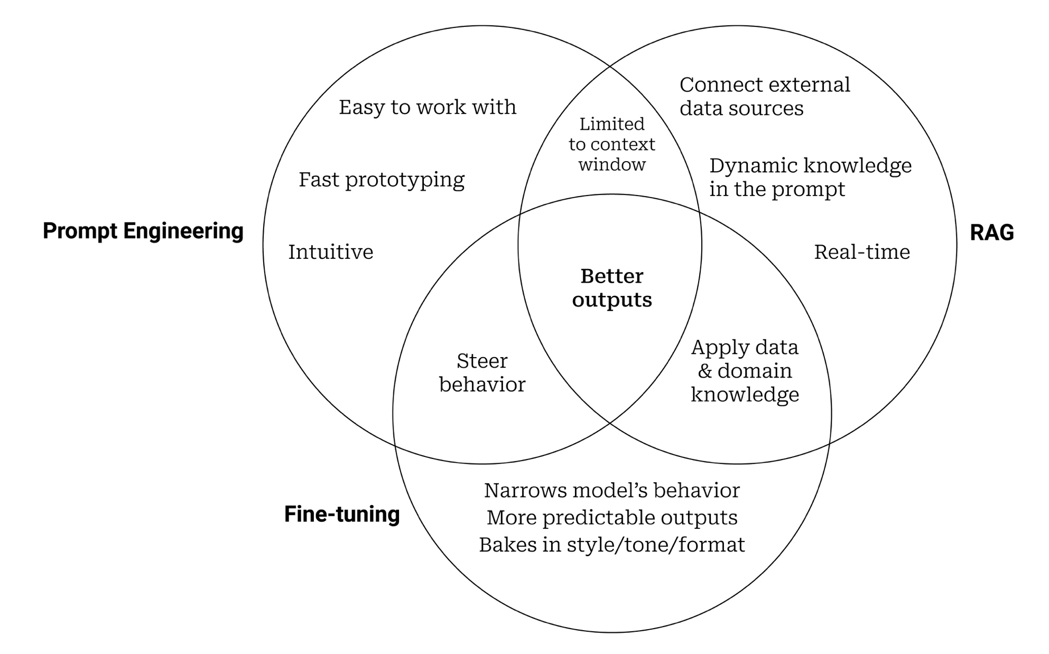
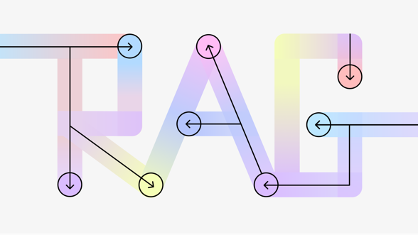
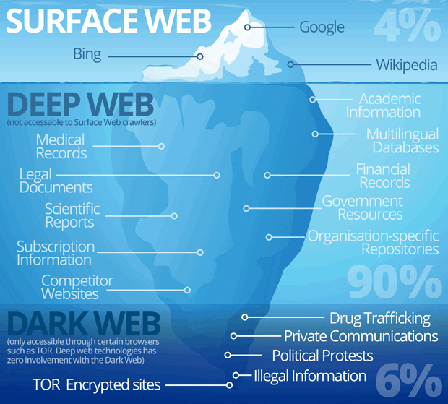
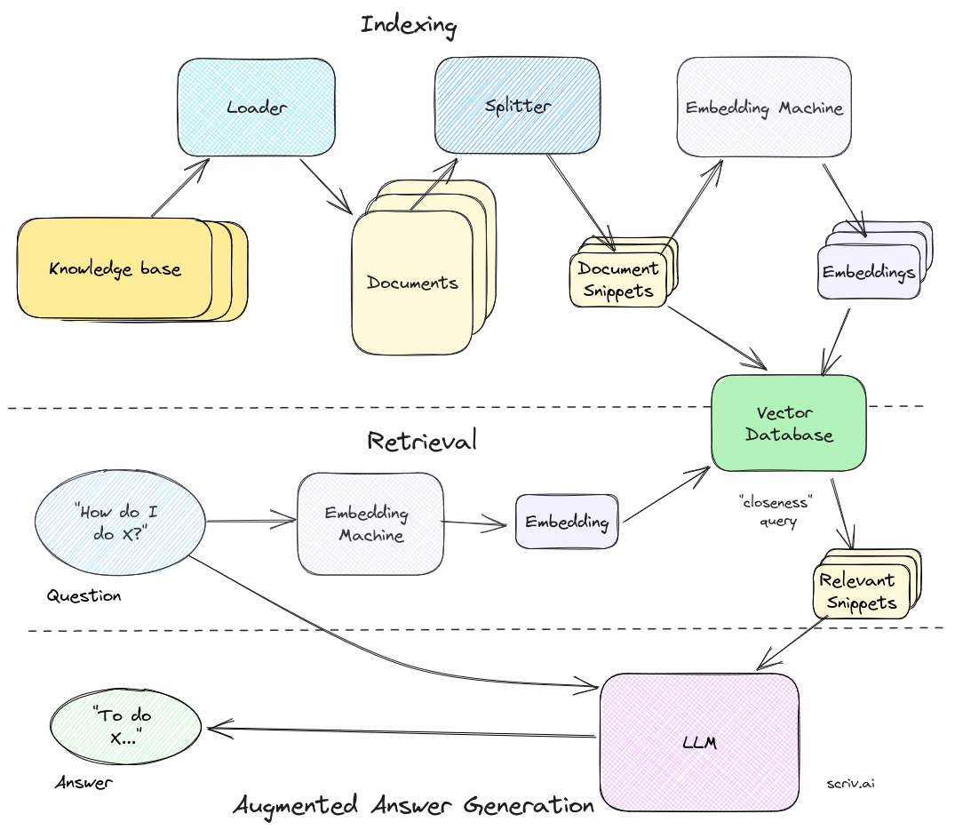
EMBRASING GENERATIVE AI FOR ENTERPRISE
Jeff Huber, CEO, Chroma
LLMs are trained on Public Domain Data, which is only 4% of knowledge.
LLMs to be Enhanced/Extended with
Proprietary Data to get best output for enterprise use.
Notes:
A major issue with adopting Gen AI tools is... their limited awareness of proprietary data, only on 4% of public domain data is useful
To overcome this, there are various solutions available
Fine tuning is an option – but its bit expensive, and inefficient when data changes frequently
Third and trending option is Retrieval Augmented Generation commonly known as RAG, our solution is built on RAG.

Slide 3









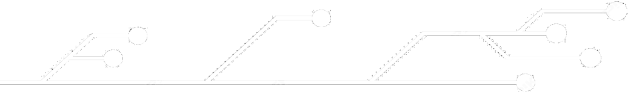



Test Manager Bot
Solution:
Idea Description:
The innovation aims to streamline manual QA tasks by integrating a dedicated QE Copilot. This innovative solution leverages machine learning algorithms to analyze existing test cases and business requirements, generating new test cases, identifying duplicates, and suggesting updates, and many more... This integration accelerates testing, enhances accuracy, and improves product quality insights for faster time-to-market.
Extract content (API > csv)
Split to Chunks
Embedding model
Knowledge Base
Question
Question Embedding
Semantic Search
Generated Answer
LLM
Generate Prompt
Top N Results
(in Chunks)
Benefits:
30%
Productivity Improvement in Test Case Creation, Maintenance, and Management.
Limitations:
Sensitive to right prompts for yielding accurate results
If the ask involves internal/new info not in knowledge base and LLM, requires descriptive prompts
Next Steps:
Rollout in QE process
Improve TestRail Data Quality & Quantity
QE prompt library reference
LLM upgrades with new and powerful releases
Notes:
The initial version was called Test Manager Bot
Based on the POC, and piloting done, we found that it helped to improve test design and maintenance productivity by 30%

Slide 4





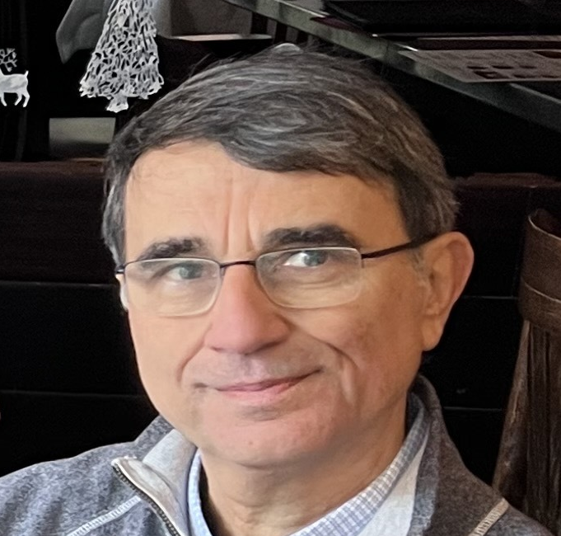



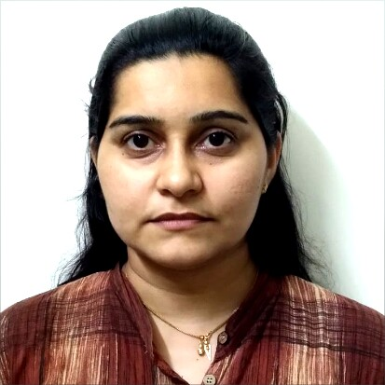









QE TO ENGINEERING TEAM SCOPE EXPANSION
Benefit
50%
Unified
Enterprise Virtual Assistant
Reduction in clarifications or time identifying specific details on existing tools.
Generative AI
One stop for All project information
Inquire about project details
Review & provide Feedback
Suggestions & Recommendations
User-friendly Interface | Integrated Data Management | Intelligent Query Handling | Secure and Reliable | Cost Efficient
Rosti Alpin
Chaitanya T
Robin Alex
Rithwik S
Juney Jestin
Enhanced Vector Store
Extract Through API
Source Data
Clean & Transform Data
Generate Embeddings
Store In Vector DB
Source Systems
Notes:
We extended solution with Confluence, JIRA, and some documentation sites in Github
We have also improved data processing, which includes cleansing and transformation
This helped us to ease clarification process, approximately 50% reduction in time;
We have rebranded Test Manager Bot as EVA which is Enterprise Virtual Assistant, and socialized with scrum team

Slide 5









FEATURES & LIMITATION
Features
Direct Inquiry
Processed Data
Review & Feedback
Conversational
Creation Query
Directly responds to queries about existing data.
Summarize information from various documents
Review existing data and provide feedback
Follow-up queries based on ongoing chat session
creating new content with reference to existing data.
Limitation
Sensitive to Prompt
Obsolete/Outdated Data
Context Size Limitation
Terms and Terminologies can affect the responses.
Incorrect answeres from incorrect data in source.
Limitation to process large amount of data in a Single query.
Using keywords, terminologies, and jargons as same as the source documents can help to produce accurate and reliable responses.
Better the source data, better the results. Cleanup source systems and/or identifying and implementing data filtering and cleansing logics.
Targeted questions on specific content provides better results versus, generic question which require large amount of data to be analyzed.
Notes:
Here is the consolidated view of Features and Limitations; we will see these in Demo

Slide 6

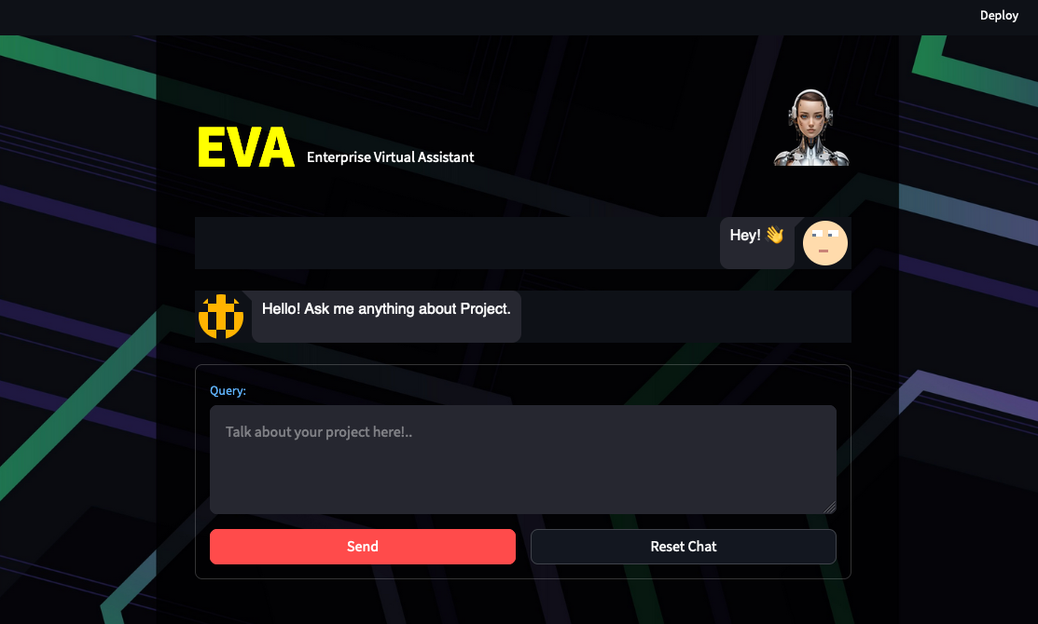
DEMO
Enterprise
Virtual
Assistant

Slide 7







Constraints - Accuracy Improvements
Biggest constraint with RAG solutions is accuracy (60% to 70% in general)
Uniqueness of this solution is various approaches across end-to-end workflow to enhance accuracy (close to 90%)
Competitive advantage is, most of these are built in-house with trial and error with different approaches and picking best; such info is unavailable online.
Source Data Filtering
Custom Field Name Conversion
Code Value Conversion
JSON Objects
Source Data
Chunking Optimization
Custom Embeddings on limited Data
Prominent Keywords
Inner Product Search
Vector Store
Commonly Used Terms in Source systems
Avoid unnecessary additional info
Templates
Prompting
LLM Temperature
LLM Upgrades
LLM
Notes:
One of the common problem that majority faces with GenAI solutions is... accuracy
For us also, it was very Important area, in this solution, 90% of overall research and development effort was spend on improving accuracy
This is consolidated view of various approaches that we implemented,

Slide 8
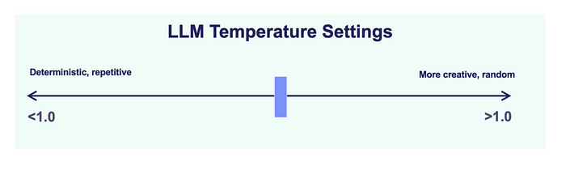

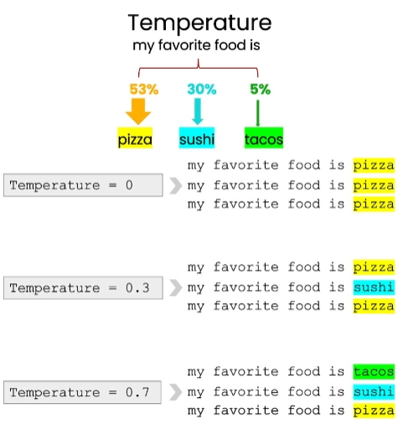



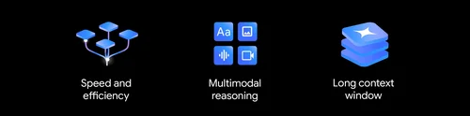

Accuracy Improvements
LLM Temperature
LLM Upgrades
LLM
Chat Bison 32k
0
1
2
Accuracy Improves
With Zero
Temperature
Notes:
LLM was one area of focus
From LLM standpoint, we are suing temperature 0, which provides accurate results with less imagination.
Also, we were using chat bison first, which we recently upgraded to Gemini 1.5 Flash, and then 2 Flash.

Slide 9
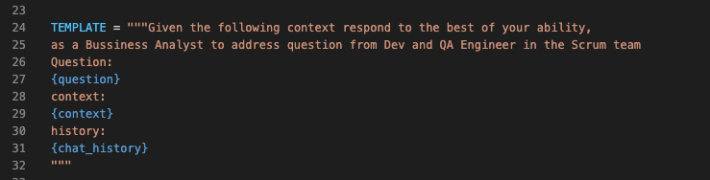
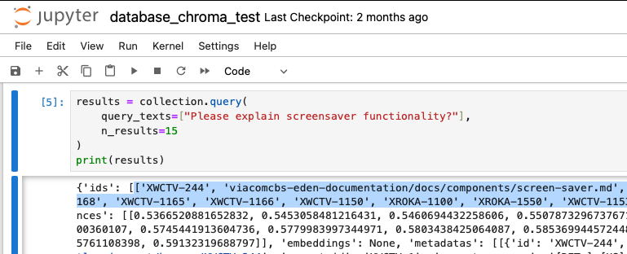
Accuracy Improvements
Commonly Used Terms in Source systems
Avoid unnecessary additional info
Templates
Prompting
Please explain screensaver functionality?
The screensaver functionality is designed to prevent screen burn-in on TVs by ensuring that all pixels on the screen change at least every 15 minutes. This is a global requirement for all platforms, including WebPlex, PlayPlex+, and CTV. Here's a breakdown of the screensaver functionality based on the provided context: ……
Please explain animation that comes in screen when idle?
The question you're asking about the animation that appears on the screen when idle is a bit ambiguous. To give you a clear answer, I need more information. …
Please explain screensaver functionality which comes when user do not do any navigation for 15 minutes on any screen, when video is not playing?
The question you're asking about screensaver functionality is not directly addressed in the provided context. However, based on the information provided, I can infer the following: … (Guess work based on public info)…
Notes:
We use Jupyter note to debug and enhance prompts

Slide 10
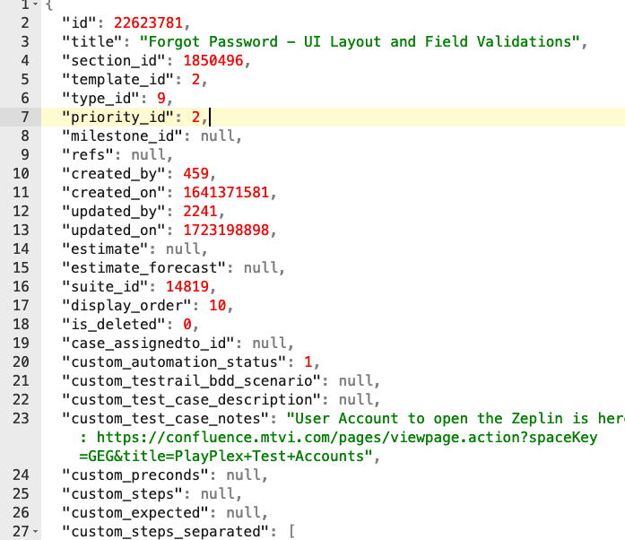
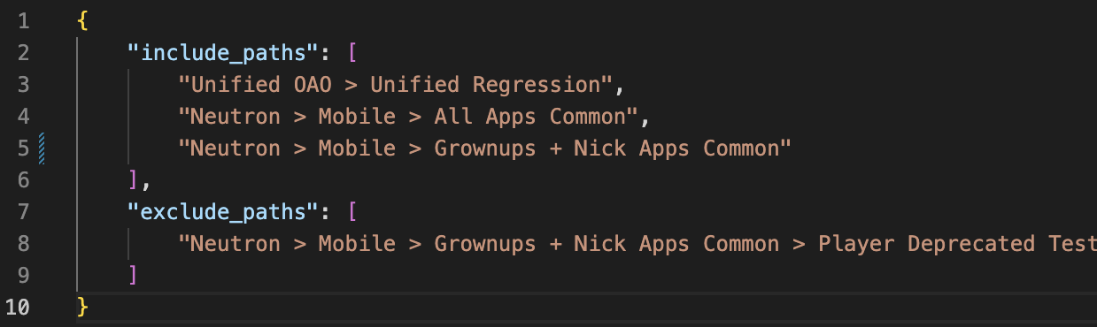
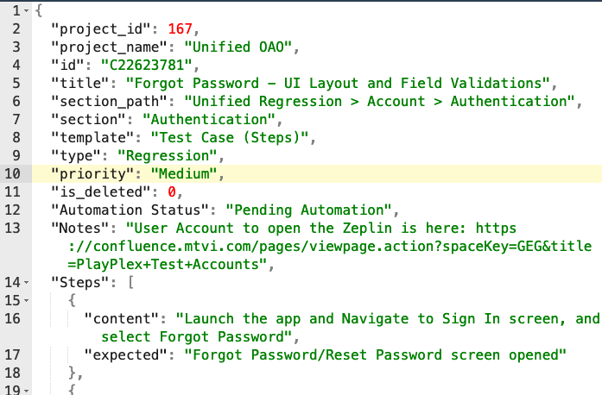
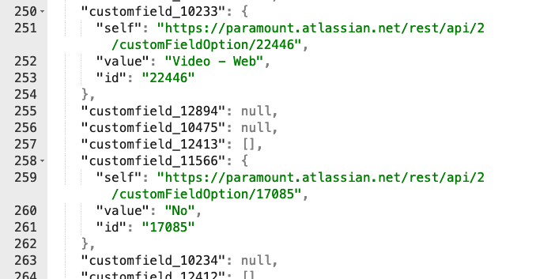
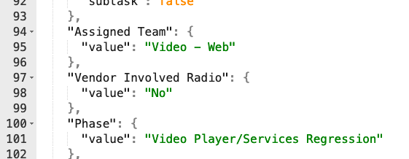
Accuracy Improvements
Source Data Filtering
Custom Field Name Conversion
Code Value Conversion
JSON Objects
Source Data
Notes:
We have also enhanced Data Extraction, filtering, cleansing, transformation and storage
Also we observed that, LLMs can understand items better when stored as objects, so we are storing data as JSON objects
Source data filtering – avoid outdated data
Change custom fieldname to readable format

Slide 11
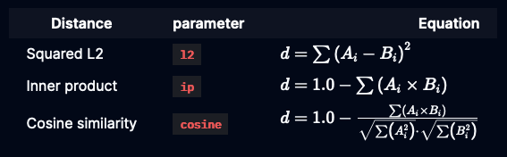
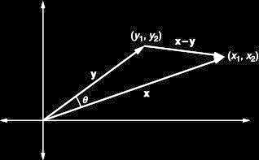
Accuracy Improvements
Chunking Optimization
Custom Embeddings on limited Data
Prominent Keywords
Inner Product Search
Vector Store
Meaningful chunks -> Better output
1 item per chunk
(1 TC, 1 ticket, 1 document etc.)
[-3.06521934e-02 -3.53801548e-02 -6.95382580e-02 1.58076081e-02\n 8.65121558e-02 7.64674470e-02 -3.40875722e-02 7.99053698e-04\n 6.20862376e-03 -3.10007129e-02 4.05142382e-02 3.91196460e-03\n 5.90500943e-02 -1.24804338e-03 3.15842708e-03 -3.78849218e-03\n -2.98588574e-02 -7.20780343e-02 -2.67001707e-02 -3.88433039e-02\n 3.99139652e-04 -9.45501146e-04 -3.87565792e-02 1.11051723e-02\n 1.60081740e-02 -1.66128874e-02 -2.80354004e-02 9.26906019e-02\n -7.88193047e-02 -7.11117014e-02 4.67596501e-02 1.63394269e-02\n 1.75295249e-02 6.48970827e-02 6.95404410e-02 -6.35145158e-02\n -6.07158095e-02 -4.22590710e-02 -1.37953488e-02 -2.85366760e-03\n -9.84692350e-02 -7.96437338e-02 -3.49708796e-02 7.12566301e-02\n 4.02407385e-02 -2.82094385e-02 -8.55099335e-02 -9.57523435e-02\n -1.20885428e-02 -1.32272029e-02 -4.91950102e-02 -3.51785459e-02\n 2.75406875e-02 8.21197331e-02 -3.06846318e-03 1.86822526e-02\n -6.20154403e-02 8.47449377e-02 3.74610685e-02 4.35948148e-02\n 3.94343287e-02 -3.92845199e-02 -1.30540449e-02 1.03658006e-01\n -9.38416496e-02 6.77622184e-02 -1.00963041e-01 -2.36473102e-02\n 3.86128179e-03 2.85609756e-02 -9.09916610e-02 6.04849756e-02\n -3.48338485e-02 3.46191674e-02 2.67951339e-02 -1.42893083e-02\n -2.78169475e-02 -1.07798189e-01 4.89139706e-02 -4.90841530e-02\n -9.98183265e-02 -4.38478179e-02 -8.91507193e-02 3.79901938e-02\n 6.56744093e-02 1.01956703e-01 5.69978282e-02 7.71451741e-05\n -3.02731637e-02 -5.17053390e-03 6.56496128e-03 -8.97639766e-02\n 1.28666721e-02 3.23932320e-02 -1.03664966e-02 -2.57690903e-02\n -2.57896073e-03 -5.84855080e-02 -5.15142046e-02 7.85846189e-02\n -
...
...]
Custom Embedding including Keywords
id : C22623781 | type : Test Case |
project_name : Unified OAO |
section_path : Unified Regression > Account > Authentication |
title : Forgot Password - UI Layout and Field Validations |
type : Test Case |
title : Forgot Password - UI Layout and Field Validations |
section : Authentication |
title : Forgot Password - UI Layout and Field Validations |
link : https://paramount.testrail.io/index.php?/cases/view/22623781 |
title : Forgot Password - UI Layout and Field Validations |
platform_and_test_type : TVOS - Regression, Roku - Regression, AndroidTV - Regression, FireTV - Regression, VIZIO - Regression, TIZEN - Regression, iOS - Regression,A ndroid - Regression, LG - Regression, Hisense - Regression, Comcast - Regression, Cox - Regression |
keywords : regression , betplus , content , expected , submit , title , password , field , email , try
Notes:
Vector Store enhancements were done in terms of chunking, keyword generation, vector search, custom embeddings etc.
With respect to vector store, we found it more efficient when a chuck has meaningful and complete info; we found it more efficient when I test case, page or ticket is converted into a chunk.
Also, we were facing issues with vector search results against the keywords in prompt, the LLM accuracy depends on the vector search result. We revised our vector embedding to eliminate detailed description and commends which could improved the quality of vector search.
To compensate gap by removing description and comment, we included top 10 keywords too as part of embedding by processing description and comments.

Slide 12



NEXT STEPS
Pilot
Rollout
Current: NS Connected TV Team
Expand to All QA & Other teams
Expand
Data
Current:
3 TestRail Project
2 Github Repo
16 JIRA projects
1 Confluence Space
Enhance
On Feedback
Completed: Slack Integration
Analysis: Voice Support,
Agentic AI (MCP, A2A etc.)
Notes:
The tool is currently used by NS Connect TV Teams; Cloud engineering team have agreed to help with could deployment during this quarter, which helps to expand further.
Also, we are continuously expanding our data with more projects, wiki spaces, and documentation repos.
Also, we are enhancing based on feedback, one feedback we could develop is slack integration.
Another item is, we are exploring AI agents, especially prompts into action.

Slide 13










Q&A
Enterprise Virtual Assistant
By MQE Team

Slide 15
APPENDIX

Slide 16
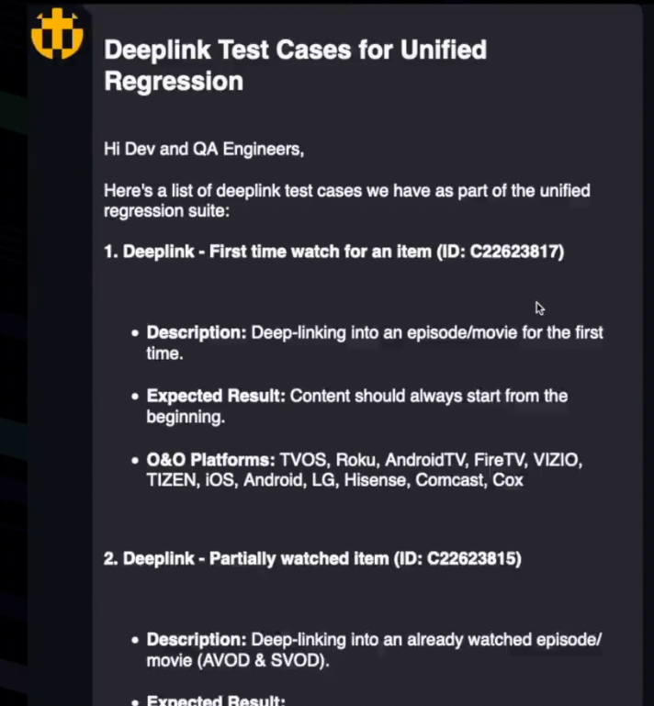
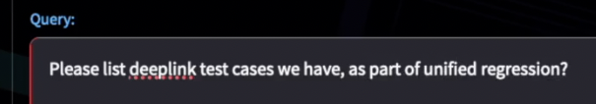
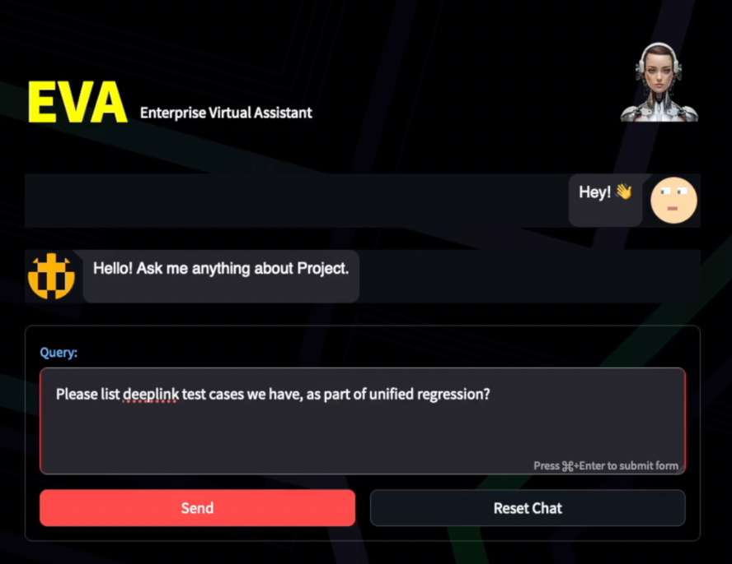
DEMO - FEATURES
Direct Inquiry
Directly responds to queries about existing data.
Notes:
* First one is direct inquiry
In this we are asking existing test cases for a feature, and it gave a straightforward answer

Slide 17
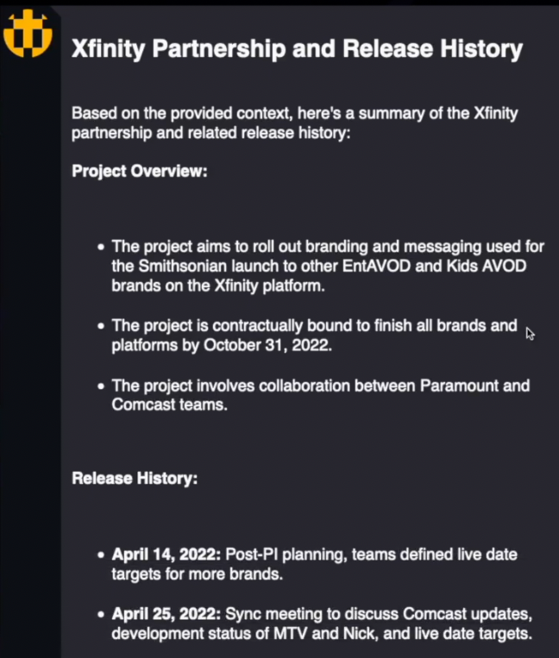
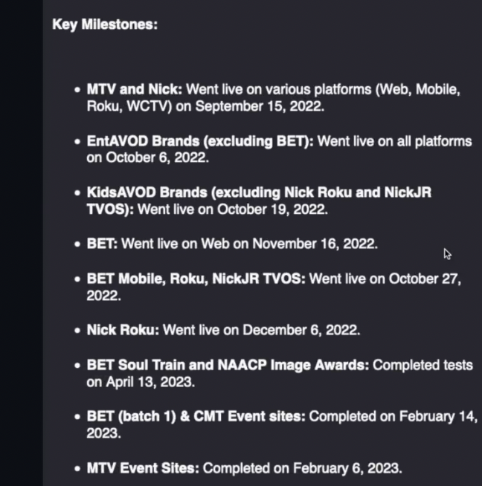

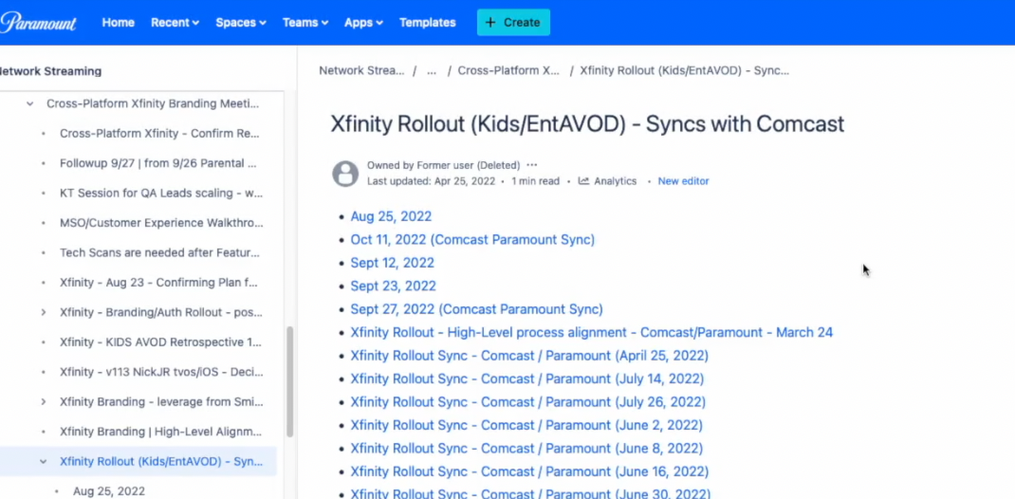
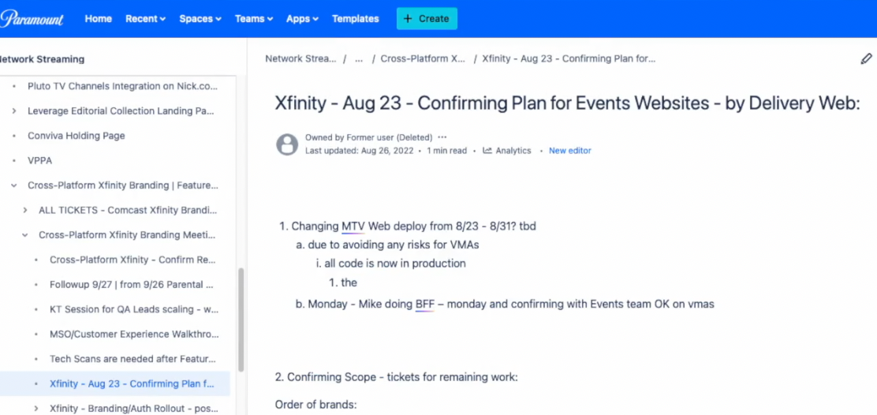
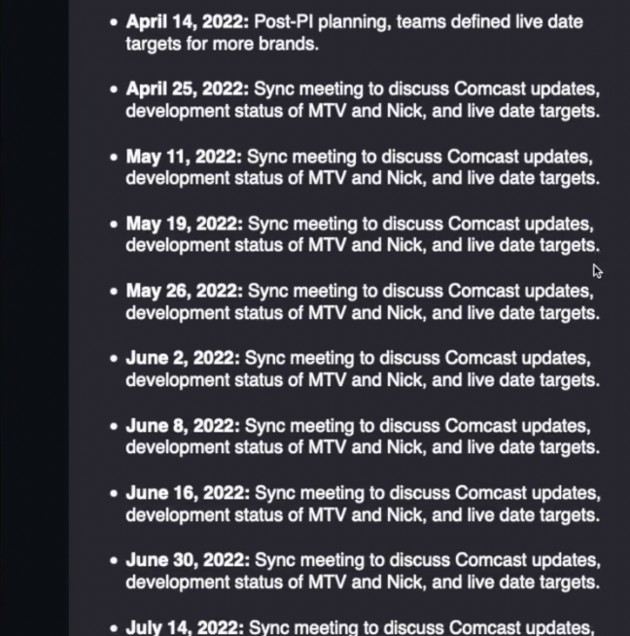
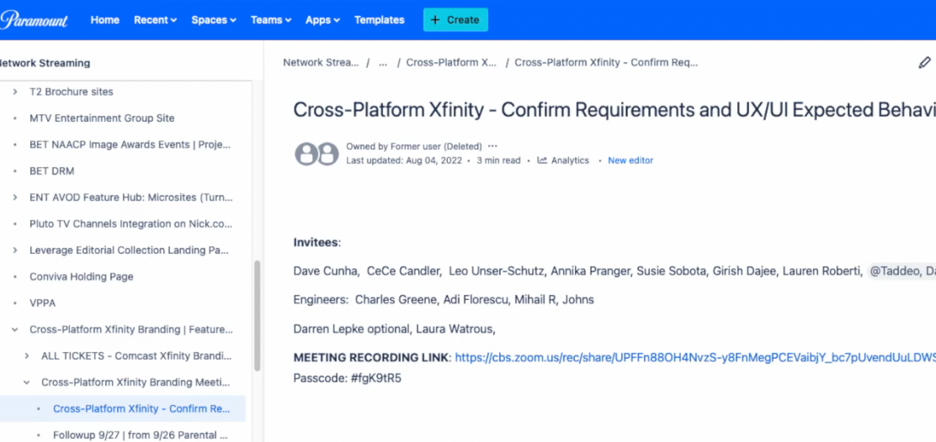
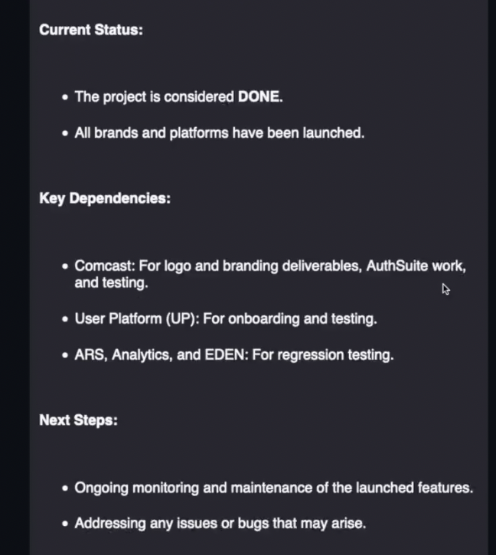
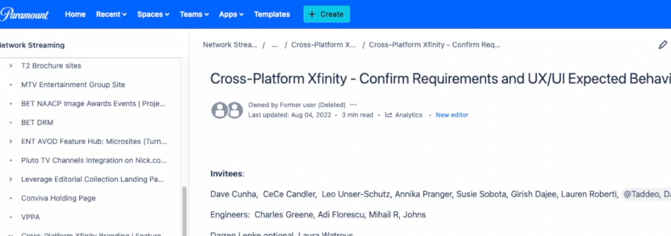
DEMO - FEATURES
Processed Data
Summarize information from various documents
Notes:
Next one is on processing data and providing a consolidated view
In this case we queried on partner integration project, for which data is scattered in various confluence pages.
EVA could review and provide a consolidated overview..

Slide 18
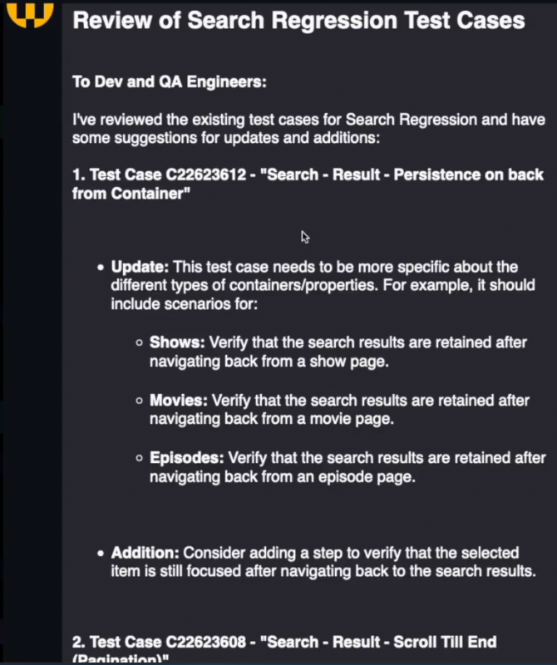
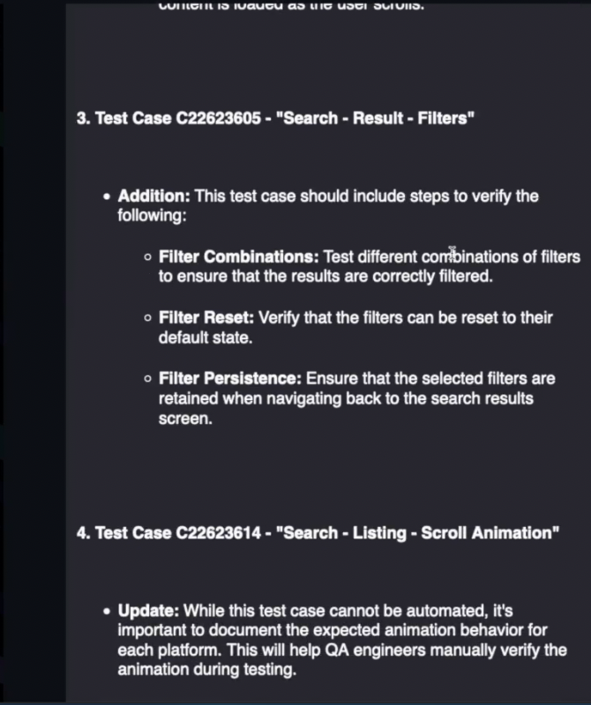
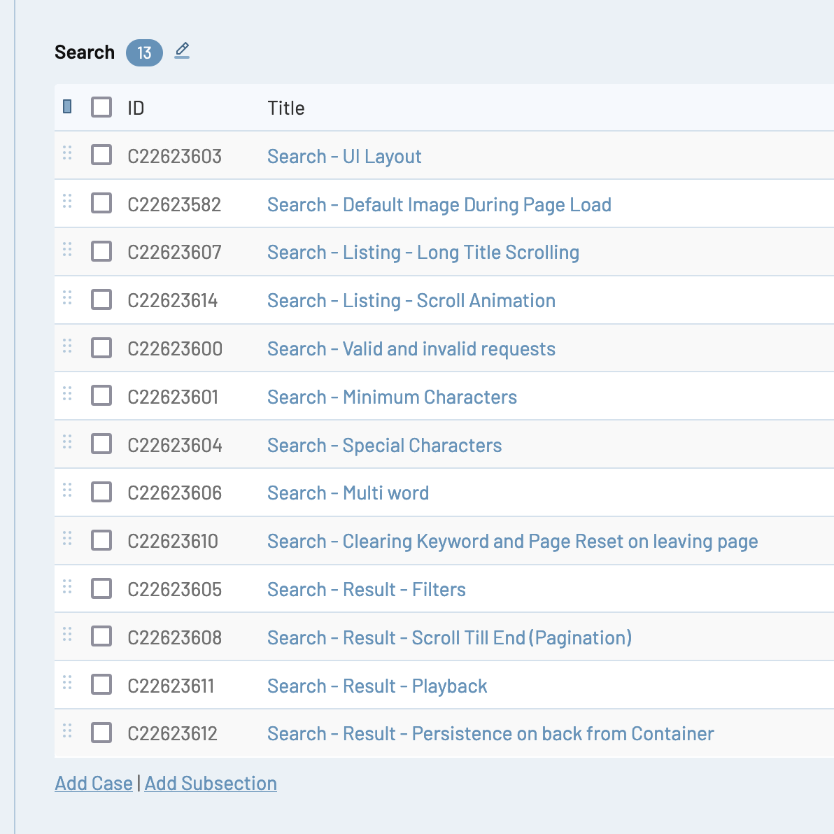
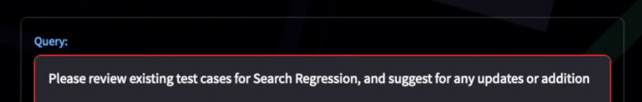
DEMO - FEATURES
Review & Feedback
Review existing data and provide feedback
Notes:
* Next one is about reviewing and providing feedback
* In this case we have requested EVA to review Search test cases
* It looked at search test case and provided feedback

Slide 19
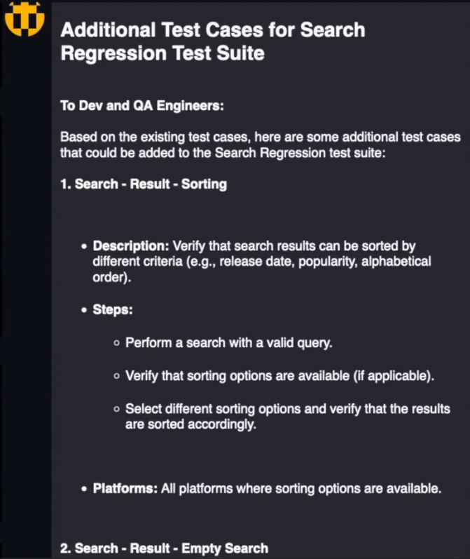
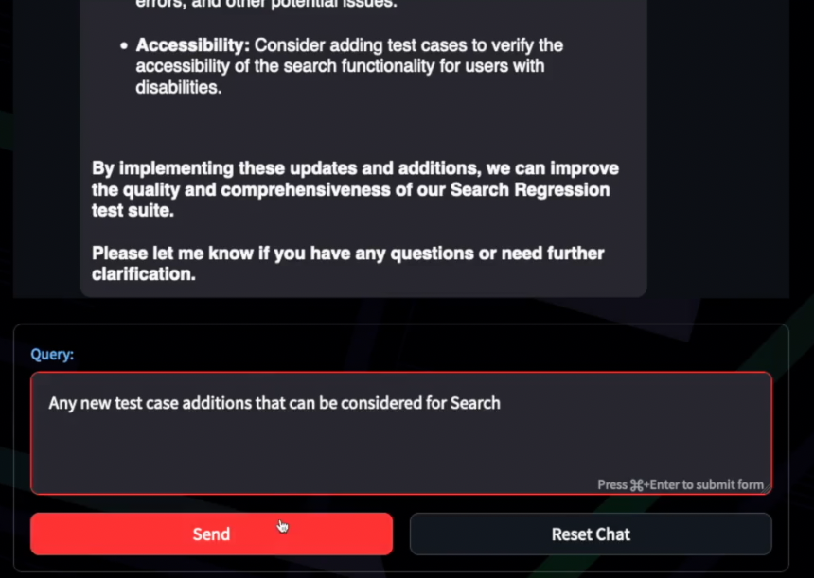
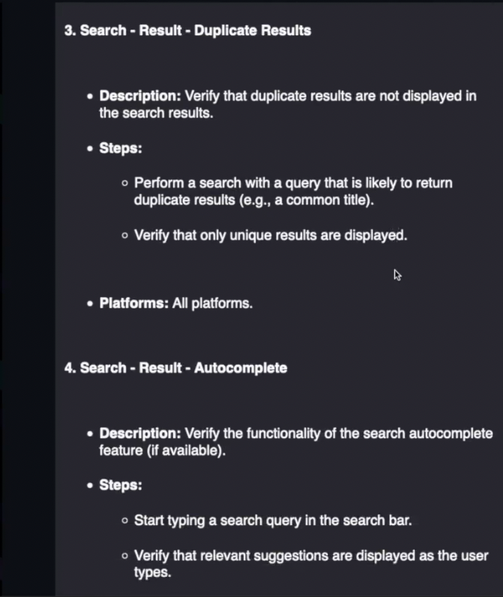
DEMO - FEATURES
Conversational
Follow-up queries based on ongoing chat session
Notes:
Next one is Conversational queries.
EVA support long conversation with history awareness
In this case we are asking a follow up query to Test case review
We asked for new test cases, and it provided new test cases that can be added

Slide 20
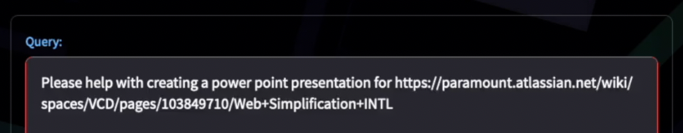
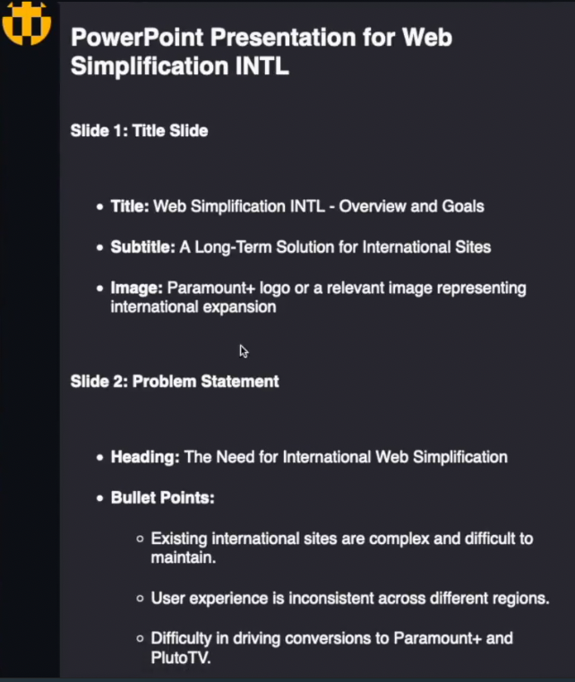
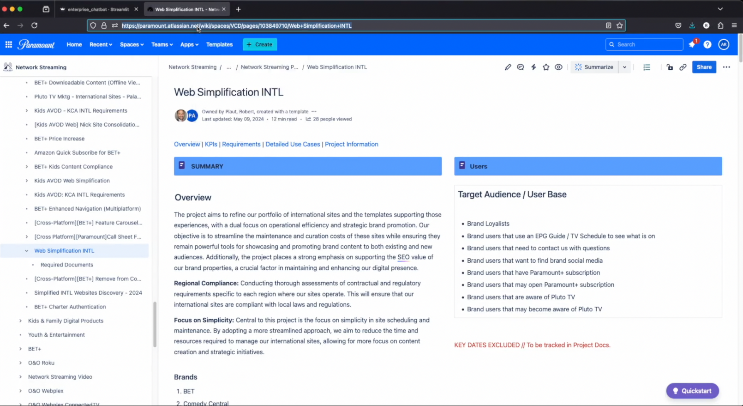
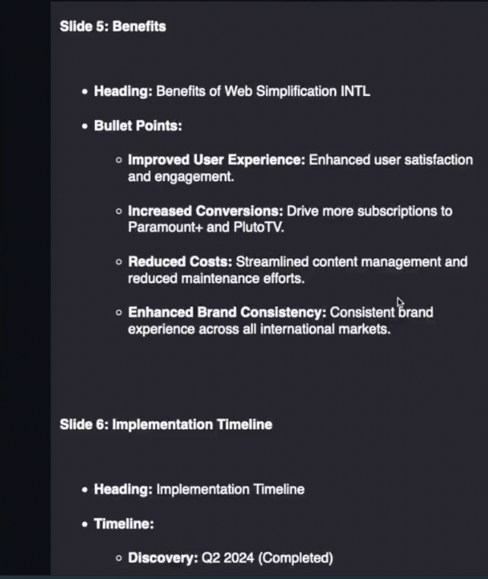
DEMO - FEATURES
Creation Query
creating new content with reference to existing data.
Notes:
* Next one is creating new content
* In this case, we are giving a confluence document link, and asking to help with a PPT
Eva analyzed data the data from the page, and provided PPT slide suggestion.
One point to note is; If you look at the sample prompts used in the demo, you can find it very simple and straight forward, which was achieved by data enhancements.

Slide 21
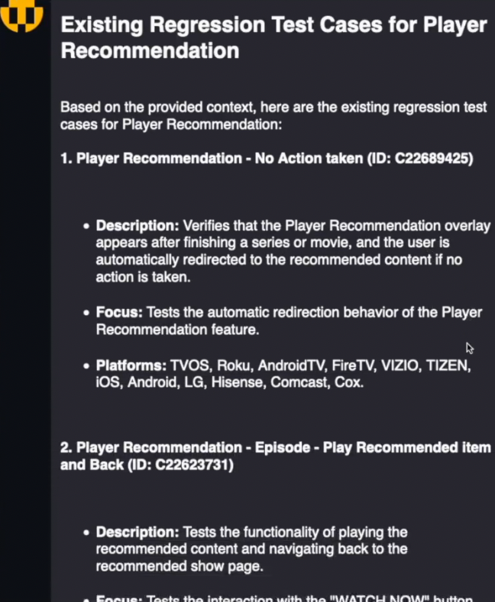
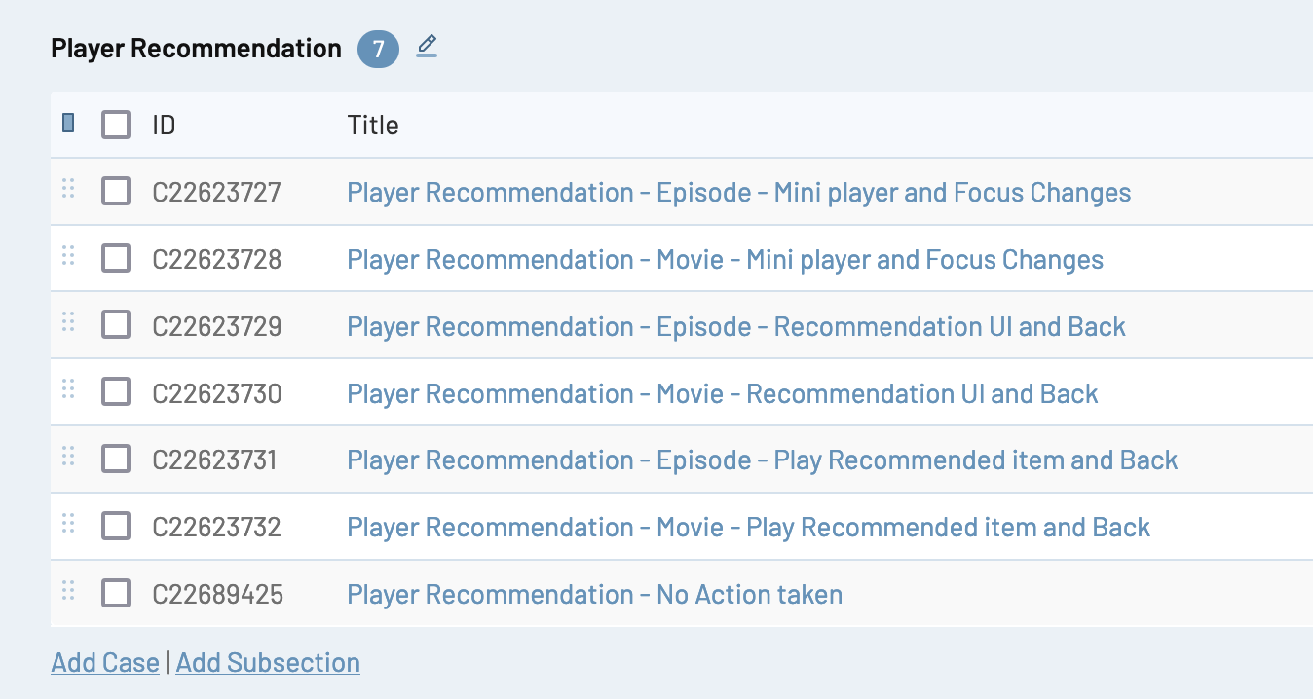
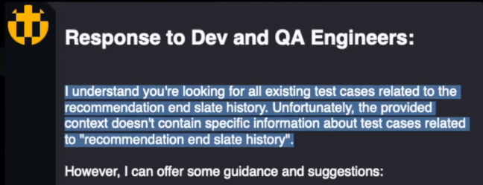
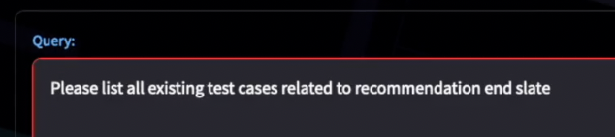

DEMO – LIMITATION & WORKAROUNDS
Sensitive to Prompt
Using keywords, terminologies, and jargons as same as the source documents can help to produce accurate and reliable responses.
Terms and Terminologies can affect the responses.
Notes:
* Next, we will see the limitations
One limitation is its sensitive to prompts
We have to use exact terminology used in JIRA or Confluence to get right results.
In this case Player Recommendation and Recommendation end slate, refers to same functionality; but we got result when we used the one that is documented.

Slide 22
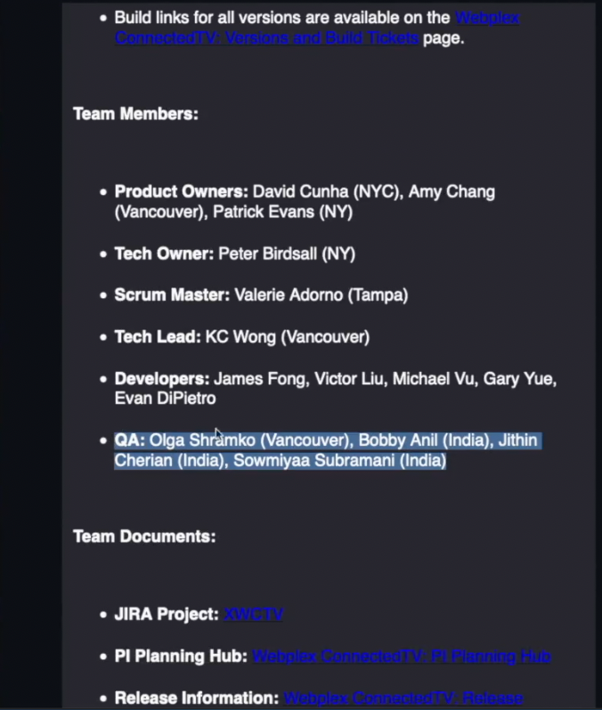
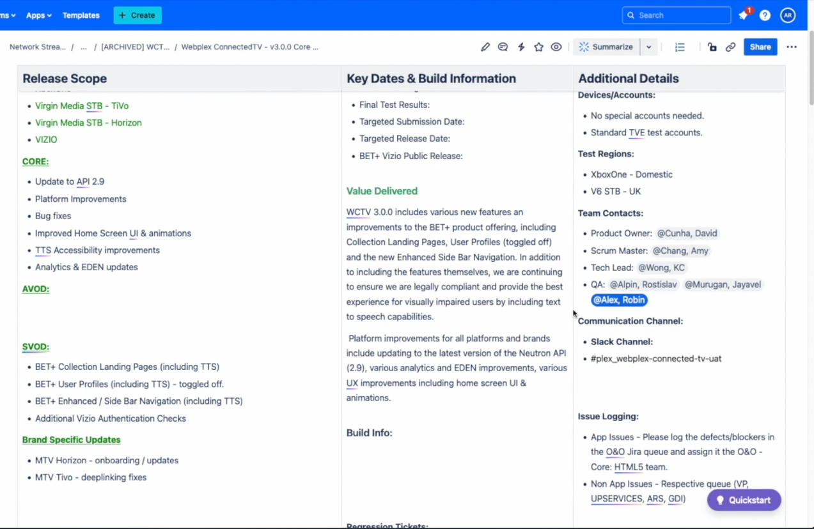
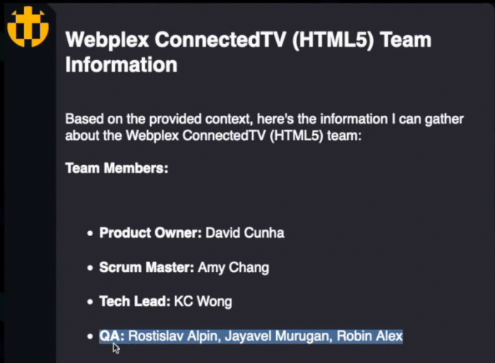


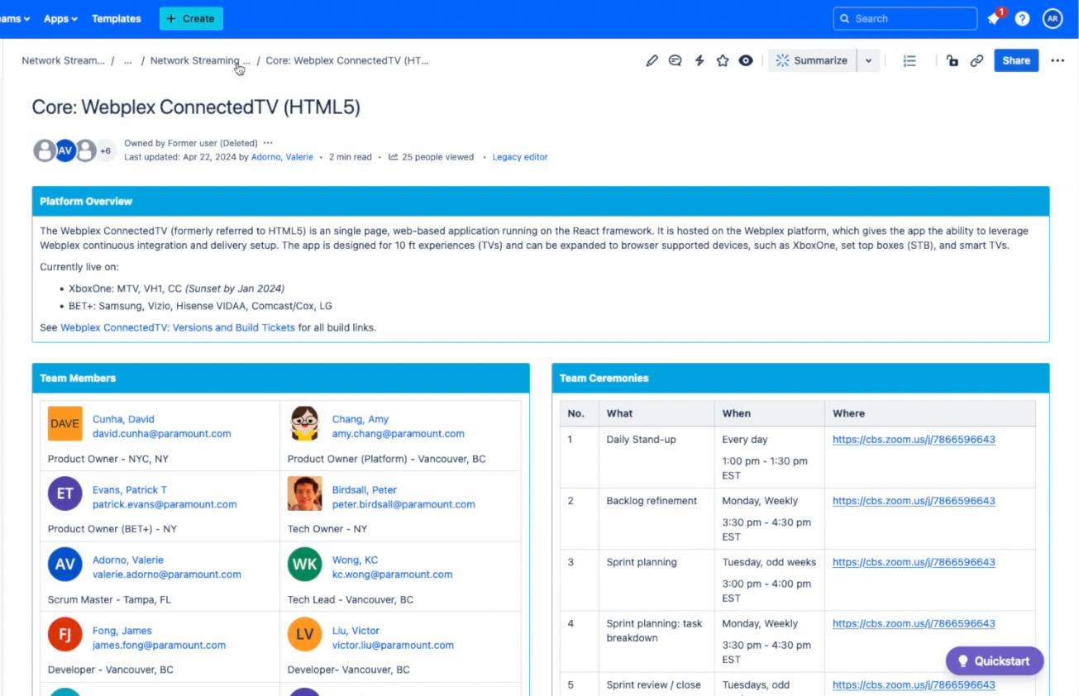

DEMO – LIMITATION & WORKAROUNDS
Obsolete/Outdated Data
Better the source data, better the results. Cleanup source systems and/or identifying and implementing data filtering and cleansing logics.
Incorrect answers from incorrect data in source.
Notes:
Another Challenge is, obsolete data in the knowledge repository
One way to overcome this, is to use keywords that points to latest documentation in vector search
Another way is, Archive the obsolete documentation and delete from knowledge base, when it is archived
Product team had helped us to cleanup our Confluence.

Slide 23






DEMO – LIMITATION & WORKAROUNDS
Context Size Limitation
Targeted questions on specific content provides better results versus, generic question which require large amount of data to be analyzed.
Limitation to process large amount of data in a Sigle query.
Smoke Test
Notes:
* Next is context size limitation
We are pulling Top 20 matching document from knowledge base and passing to LLM
Some queries require more than 20 documents to answer
Workaround is to ask targeted questions for limited documents, and it can be consolidated manually or even ask EVA to consolidate Chat history

